Slide 1



İle Oyun Geliştirme
Fuat Coşkun
Güven Salgun
Android Team

Slide 2
Agenda
Introduction
What is libGDX?
Why libGDX?
Lifecycle
Android Activity Relation
Game Loop
Threading
Features
Audio
Input Handling
Cross-platform
Graphics
Tools
Demo

Slide 3




What is libGDX?
Java based cross-platform game & application development framework
Infrastructure:

Slide 4
What is libGDX?
Modules:
GRAPHICS
APPLICATION
FILES
INPUT
NET
AUDIO

Slide 5
Why libGDX?
Write once, deploy to multiple platforms.
Only a starter class for each target platform required additionally.
ANDROID
public class MainActivity extends AndroidApplication {
public void onCreate(Bundle savedInstanceState) {
initialize(new MyGdxGame());
}}
DESKTOP
public class Main {
public static void main(String[] args){
new LwjglApplication (new MyGdxGame());
}
}

Slide 6
Why libGDX?
Desktop environment testing capability.
Hot swapping the code on desktop.
DEBUGGER
Game.class
Up to date code
new Class saved
hot swapping
continue

Slide 7
Why libGDX?
Possibility to use all low-level OpenGL elements.
Native
→
+ Powerfull high-level API
Rendering sprites & text, building UI
Playing back sound effects
Parsing JSON and XML
Gdx.gl20.glBindTexture()
glBindTexture()

Slide 8



Lifecycle
AndroidApplication
LwjglApplication
GwtApplication
ApplicationListener
create()
render()
resize()
pause()
resume()
dispose()

Slide 9
Lifecycle
start
create()
resize()
resume()
render()
running
gained focus
pause()
pause()
dispose()
lost focus
stop

Slide 10
AndroidApplication in depth
graphics.onDrawFrame();
AndroidApplication.initialize();
processRunnables();
graphics = new AndroidGraphics();
input.processEvents();
setContentView(graphics.getView());
listener.render();

Slide 11

Threading
UI widgets, textures, bitmap fonts, scene2d widgets etc. are not thread safe objects.
Gdx.app.postRunnable() used for assuring thread safety.
GL Thread
render()
use Texture
Another Thread
running

Slide 12
Features
Audio
Streaming music and sounds (MP3, WAV, OGG).
Voice recording, playback.
Input Handling
Desktop : Mouse, Keyboard.
Mobile Device : TouchScreen, Accelerometer, ...

Slide 13
Features
Cross-Platform
Interfacing with platform specific code (In App Billing)
IabInterface
buyItem(int itemId);
public static void main(String[] argv) {
LwjglApplicationConfiguration config = new
LwjglApplicationConfiguration();
new LwjglApplication(new MyGame (
new DesktopIab()), config);
}
public void onCreate (Bundle savedInstanceState) {
super.onCreate(savedInstanceState);
AndroidApplicationConfiguration cfg = new
AndroidApplicationConfiguration();
initialize(new MyGame (
new AndroidIab()) , cfg);
}
AndroidIab
buyItem(int itemId);
DesktopIab
buyItem(int itemId);

Slide 14
Agenda
Graphics
Graphics library
Rendering
Camera
scene2d
Textures and Fonts
Tools
libGDX tools
External tools

Slide 15
Graphics Module
Each version of OpenGL ES can be accessed through its respective interface. (1.0, 1.1, 2.0)
Gdx.graphics.getWidth();
Gdx.graphics.getHeight();
Gdx.graphics.getFramesPerSecond();
Gdx.gl.glClearColor( 0, 0, 0, 1 );
Gdx.gl20.glEnable(GL20.GL_NORMALIZE);

Slide 16
Graphics Module
Each version of OpenGL ES can be accessed through its respective interface. (1.0, 1.1, 2.0)
Gdx.graphics.getWidth();
Gdx.graphics.getHeight();
Gdx.graphics.getFramesPerSecond();
Gdx.gl.glClearColor( 0, 0, 0, 1 );
Gdx.gl20.glEnable(GL20.GL_NORMALIZE);

Slide 17
Graphics Module
Each version of OpenGL ES can be accessed through its respective interface. (1.0, 1.1, 2.0)
Gdx.graphics.getWidth();
Gdx.graphics.getHeight();
Gdx.graphics.getFramesPerSecond();
Gdx.gl.glClearColor( 0, 0, 0, 1 );
Gdx.gl20.glEnable(GL20.GL_NORMALIZE);

Slide 18
Graphics Module
Each version of OpenGL ES can be accessed through its respective interface. (1.0, 1.1, 2.0)
Gdx.graphics.getWidth();
Gdx.graphics.getHeight();
Gdx.graphics.getFramesPerSecond();
Gdx.gl.glClearColor( 0, 0, 0, 1 );
Gdx.gl20.glEnable(GL20.GL_NORMALIZE);

Slide 19
Graphics Module
Each version of OpenGL ES can be accessed through its respective interface. (1.0, 1.1, 2.0)
Gdx.graphics.getWidth();
Gdx.graphics.getHeight();
Gdx.graphics.getFramesPerSecond();
Gdx.gl.glClearColor( 0, 0, 0, 1 );
Gdx.gl20.glEnable(GL20.GL_NORMALIZE);

Slide 20
Graphics Module
Each version of OpenGL ES can be accessed through its respective interface. (1.0, 1.1, 2.0)
Gdx.graphics.getWidth();
Gdx.graphics.getHeight();
Gdx.graphics.getFramesPerSecond();
Gdx.gl.glClearColor( 0, 0, 0, 1 );
Gdx.gl11.glEnable(GL11.GL_NORMALIZE);

Slide 21
Rendering (Continuous vs. Non-continuous)
Default => Continous rendering (hardware frequency 50-60 fps etc.)
If many still frames => Non-continous rendering (on demand)
Gdx.graphics.setContinuousRendering(false);
Gdx.graphics.isContinuousRendering();
Gdx.graphics.requestRendering(); //Invokes render

Slide 22
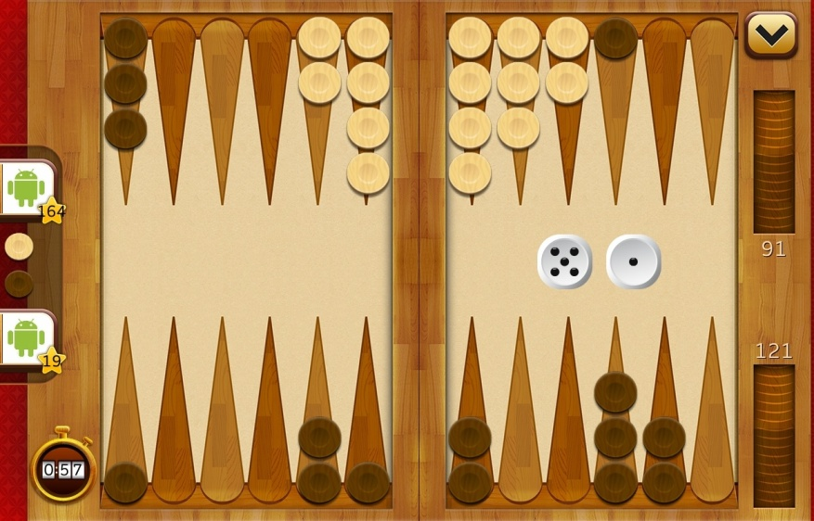
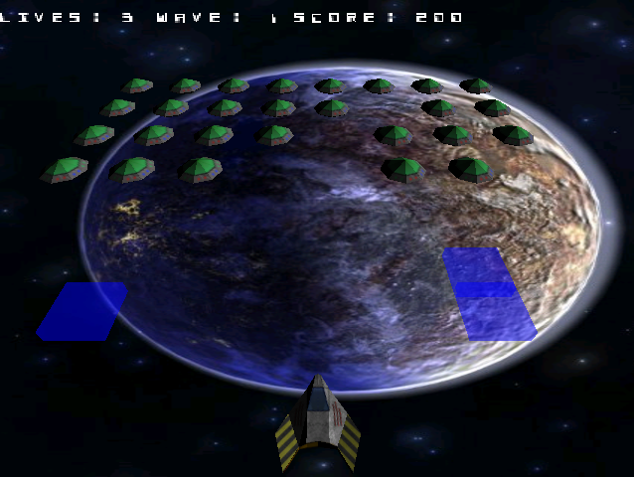
Cameras
Orthographic Camera
Perspective Camera

Slide 23
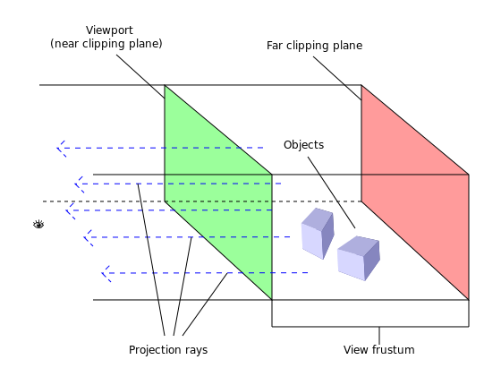
Cameras - Orthographic
Orthographic camera ignores the scaling effect, but overlaps objects.

Slide 24
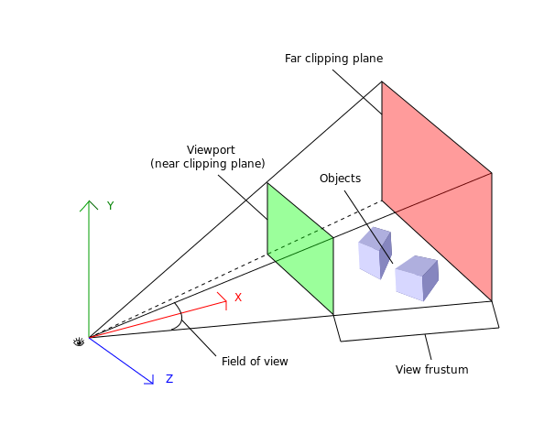
Cameras - Perspective
Perspective camera shows the objects in the distance like they are smaller.

Slide 25
scene2d
Easy to create and manipulate UI elements.
All UI elements are Java objects.
Button
Image
Label
Table
WidgetGroup
ScrollPane

Slide 26
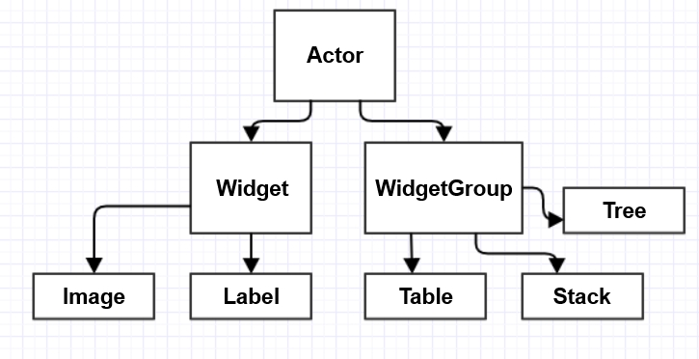
scene2d - Actors
Elements on the screen are Actors.

Slide 27
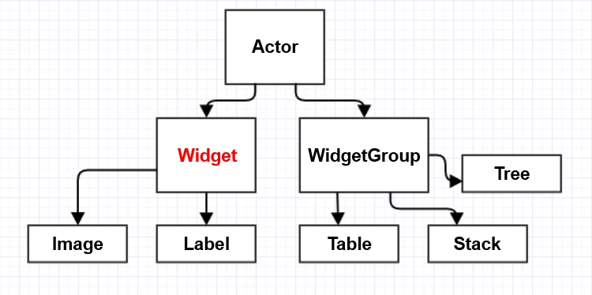
scene2d - Actors
Elements on the screen are Actors.

Slide 28
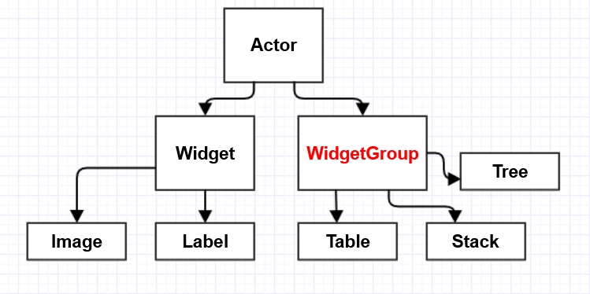
scene2d - Actors
Elements on the screen are Actors.

Slide 29
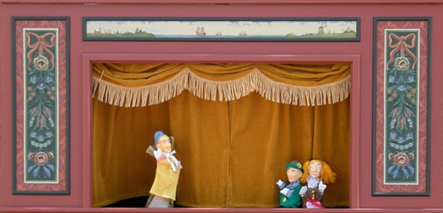
scene2d - Stage
Actors are placed on a Stage.
Stage receives input events – fires on Actors.
Draws all Actors placed on it.

Slide 30
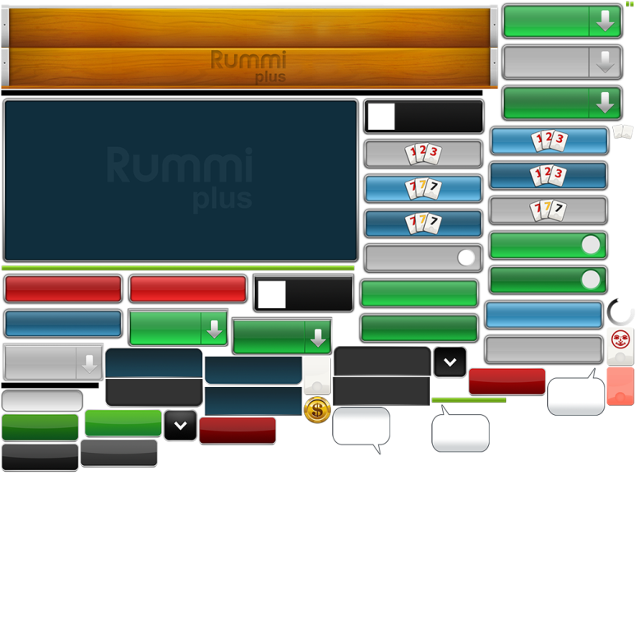
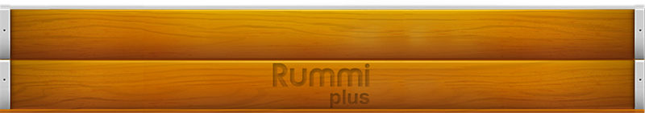
Textures - TextureAtlas
Images and textures loaded as a TextureAtlas.
A TextureAtlas contains multiple textures in one file.
A TextureRegion is obtained from the atlas and can be used as a drawable object.
BoardScreen.atlas
tile-rack
rotate: false
xy: 489, 574
size: 44, 62
orig: 44, 62
offset: 0, 0
index: -1

Slide 31
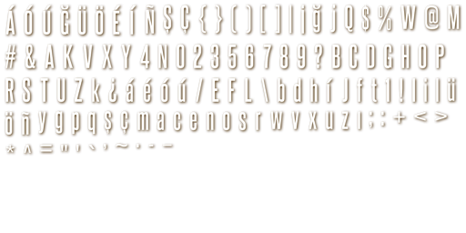

Fonts
Bitmap fonts are the generic font type in Libgdx.
TrueType fonts can be converted to bitmap fonts on the fly.
Bitmap fonts are packed just like a TextureAtlas.
steelfish.fnt
char id=32
x=195
y=155
width=0
height=0
...

Slide 32
Textures and Fonts – Direct Access
Image files can be accessed directly from the assets folder.
new TextureRegion(new Texture(Gdx.files.internal("BG.png")));
new BitmapFont(Gdx.files.internal("steelfish.fnt"),false);
//second parameter “flip” is for reverse font files.

Slide 33





Tools
Open source – provided by libGDX
Commercial Tools
TexturePacker
Hiero
Particle Editor
TexturePacker
BMFont
Glyph Designer
Spine

Slide 34
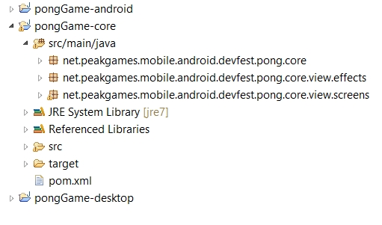
Project structure

Slide 35
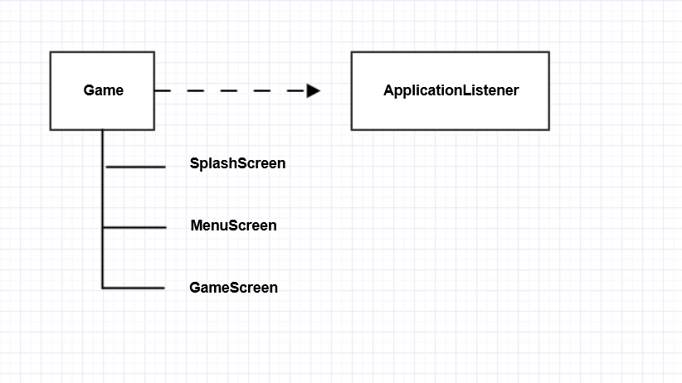
Game structure

Slide 36
Demo
Awesome Ping Pong

Slide 37

License & Resources
libGDX
http://libgdx.badlogicgames.com/
http://www.badlogicgames.com/forum/
https://github.com/libgdx/libgdx
Awesome Ping Pong
https://github.com/peakgames/AwesomePingPong
Apache License, Version 2.0

Slide 38

Thanks
Fuat Coşkun
Güven Salgun
fuat@peakgames.net
guven@peakgames.net

